Slide 1

Title slide 1
Speaker name and title
Month day, year

Slide 2
Building a Global Data Fabric to the Edge

Slide 3

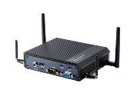
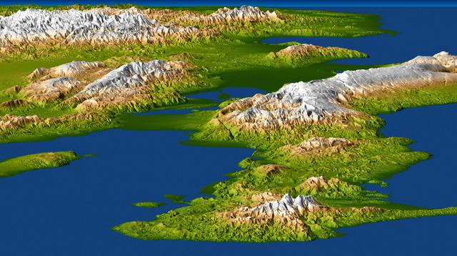
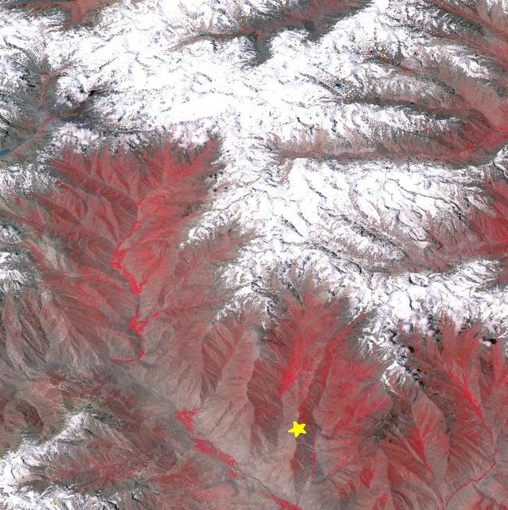
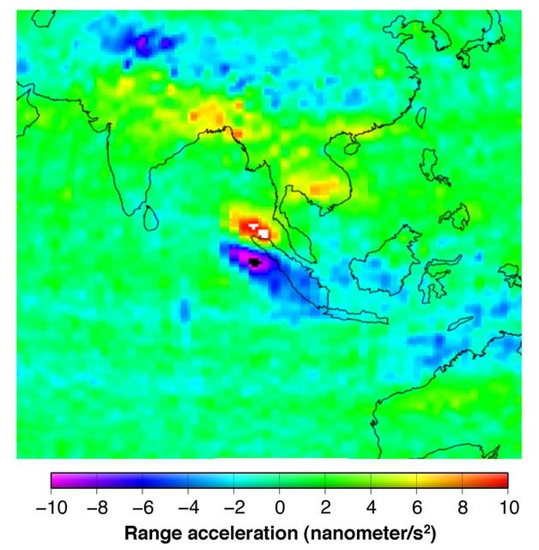
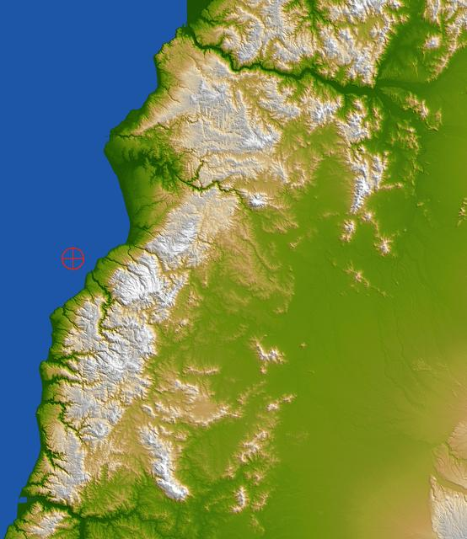

An example of intelligent edge with the HPE Ezmeral Data fabric
Regional HQ
Data Processing Pipeline
(Microservices)
Edge
Download
Categorize
Broadcast
Edge
Broadcast
/…/images
(file services)
/…/metaTable
(db services)
/…/repStream
(pub/sub services)
Request
/…/repStream
Microservices coordinated via messages published to:
Image
/…/images
/…/pipelineStream
Notes:
Preferred slide for explaining the demo. New images are being produced. A download service listens for new images and downloads them to MapR-FS (in /…/images). A Categorization service (optional) listens for the download event, runs the AWS Rekognition service, and updates the metadata record in MapR-DB. The Broadcast service also listens for the download event, and publishes a BROADCAST signal to the /…/repStream. repStream is replicated to the Edge. Soldiers request the images they want. Request events are published back to the repStream, which carries it back to HQ (multi-master replication). Requested images are conveyed to the Edge cluster via Mirroring.

Slide 4
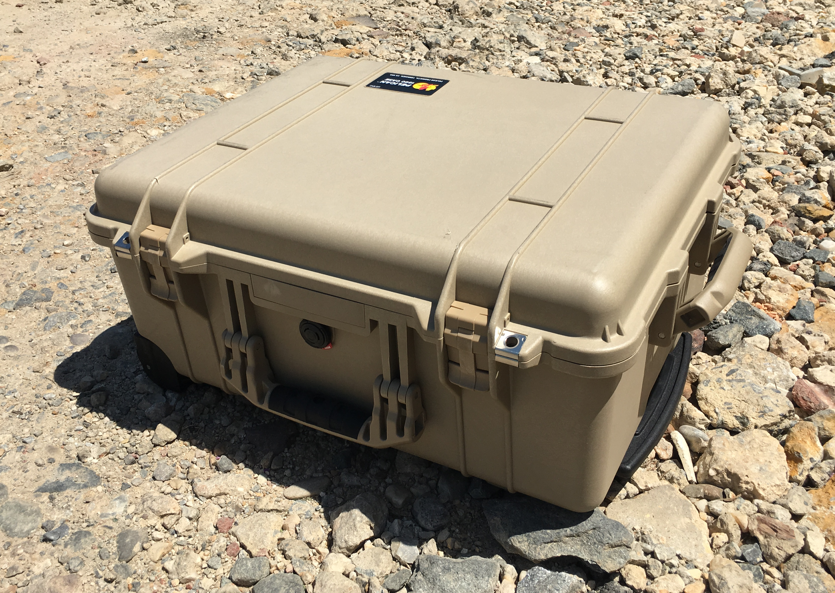
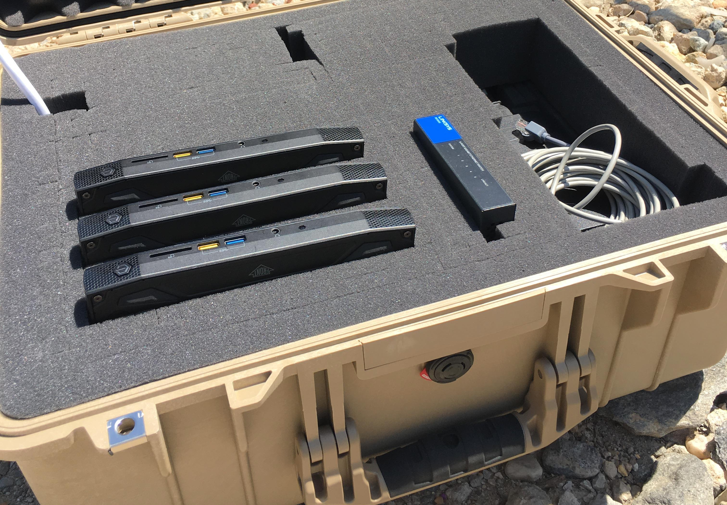
Notes:
MapR Edge is ideal for dealing with the characteristics of edge locations in industrial IoT environments. Data sources that create huge volumes of data such as oil rigs and vehicles are ideal environments for MapR Edge. Slow or occasionally connected sites can be managed by the bandwidth-aware replication in MapR. Space constrained locations that require a small computing footprint can be handled by MapR Edge, as it runs as a 3 to 5 node cluster on mini PCs such as the Intel NUCs, which are typically the size of a small book and can be bought off the shelf. Other vendors make similar PCs that are hardened for remote and even harsh locations as part of an IoT deployment.
Note: MapR is just software. Customer can choose suitable commodity hardware to meet their needs. SSD is interesting, because MapR has additional built-in optimizations for SSD, and SSDs have reliability benefits in extreme operating conditions.

Slide 5
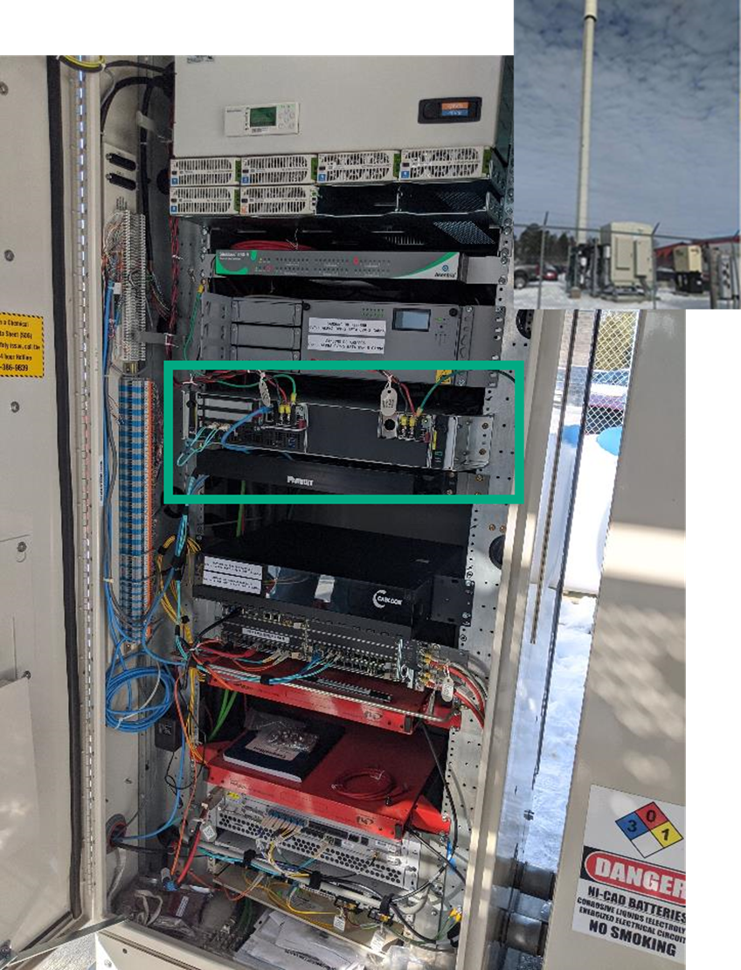
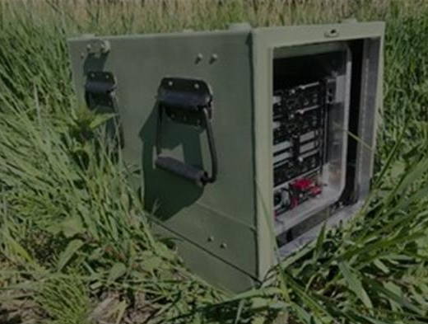
Notes:
MapR Edge is ideal for dealing with the characteristics of edge locations in industrial IoT environments. Data sources that create huge volumes of data such as oil rigs and vehicles are ideal environments for MapR Edge. Slow or occasionally connected sites can be managed by the bandwidth-aware replication in MapR. Space constrained locations that require a small computing footprint can be handled by MapR Edge, as it runs as a 3 to 5 node cluster on mini PCs such as the Intel NUCs, which are typically the size of a small book and can be bought off the shelf. Other vendors make similar PCs that are hardened for remote and even harsh locations as part of an IoT deployment.
Note: MapR is just software. Customer can choose suitable commodity hardware to meet their needs. SSD is interesting, because MapR has additional built-in optimizations for SSD, and SSDs have reliability benefits in extreme operating conditions.

Slide 6


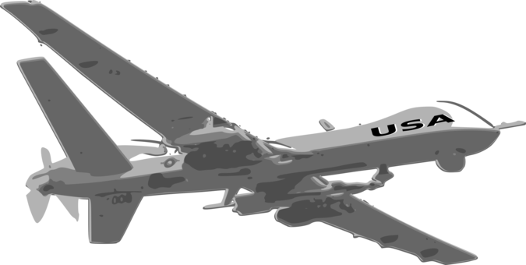
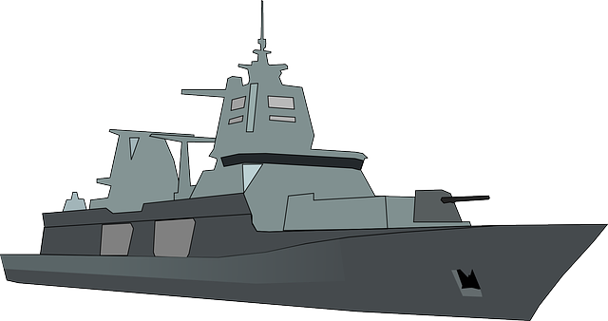

Deploying an Edge-to-Cloud Data Fabric with HPE EZMERAL
ML/AI
on information collected globally
Regional Fixed-Site Data Center
Broadcast
Tactical Edge
Request
Information Consumers running Mission Apps
Data Collection & Processing
Deliver
Notes:
So, we let our customers synchronize data across cloud providers. We leverage mirroring and replication to enable cloud neutrality.

Slide 7
Deploying an Edge-to-Cloud Data Fabric with HPE EZMERAL
ML/AI
on information collected globally
Regional Fixed-Site Data Center
Tactical Edge
Information Consumers running Mission Apps
Data Collection & Processing
Notes:
So, we let our customers synchronize data across cloud providers. We leverage mirroring and replication to enable cloud neutrality.

Slide 8
Deploying an Edge-to-Cloud Data Fabric with HPE EZMERAL
ML/AI
on information collected globally
Regional Fixed-Site Data Center
Tactical Edge
Information Consumers running Mission Apps
Data Collection & Processing
Notes:
So, we let our customers synchronize data across cloud providers. We leverage mirroring and replication to enable cloud neutrality.

Slide 9
Deploying an Edge-to-Cloud Data Fabric with HPE EZMERAL
ML/AI
on information collected globally
Regional Fixed-Site Data Center
Tactical Edge
Information Consumers running Mission Apps
Data Collection & Processing
Notes:
So, we let our customers synchronize data across cloud providers. We leverage mirroring and replication to enable cloud neutrality.

Slide 10
Deploying an Edge-to-Cloud Data Fabric with HPE EZMERAL
ML/AI
on information collected globally
Regional Fixed-Site Data Center
Tactical Edge
Information Consumers running Mission Apps
Data Collection & Processing
Notes:
So, we let our customers synchronize data across cloud providers. We leverage mirroring and replication to enable cloud neutrality.

Slide 11
